Slide 1

Engineering Research and innovation - 1
AI-Based Acoustic Wave Monitoring System for Rail Defect Detection and Predictive Rail Health Monitoring
Artificial Intelligence · Embedded Systems · Signal Processing · IoT
Domain: Smart Railway Infrastructure
Team: Atharva Bhagwat, Payal Kainge
Guide: Medha Wyawahare, HoD ENTC, VIT Pune
Department of Electronics & Telecommunication Engineering · Mid Semester Evaluation
01
Notes:
Good [morning/afternoon], I am presenting our EDI project titled AI-Based Acoustic Wave Monitoring System for Rail Defect Detection and Predictive Rail Health Monitoring. This project combines embedded sensing, signal processing and AI to improve railway safety. Over the next few minutes I will walk you through the motivation, our literature review, the research gap we identified, and the work completed so far.

Slide 2
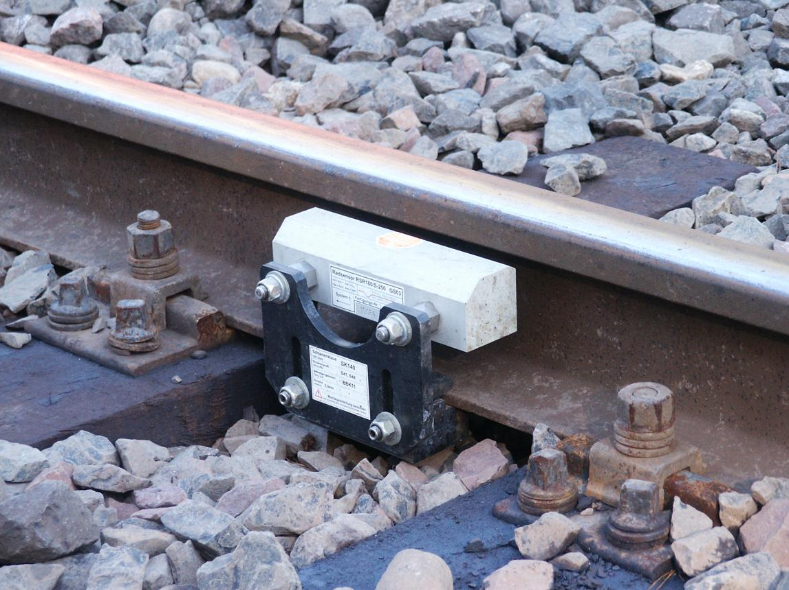





INTRODUCTION
Why Railway Health Monitoring Matters
Undetected rail cracks and geometry defects are a leading cause of derailments worldwide.
Manual inspection is periodic, labour-intensive, and depends heavily on inspector experience.
Vibration and acoustic signatures change measurably before a defect becomes visually severe.
Continuous onboard sensing enables early, low-cost, and scalable defect detection.
Rail Track — Continuous Monitoring Zone
Train
Sensor
STM32
AI
Alert
System data flow: signal is captured, digitised, analysed and escalated automatically.
02
Notes:
Railway safety depends on catching defects early. Manual inspection cannot scale to thousands of track kilometres, and it is subjective. Vibration and acoustic monitoring lets us listen to the track continuously through the wheel-rail interaction. Our system flow is simple: the train excites the rail, a sensor captures the vibration, the ESP32 digitises and pre-processes it, an AI model classifies the signal, and an alert is raised if a defect is likely.

Slide 3

LITERATURE REVIEW · PART 1
Comparative Study of Prior Work
Paper | Method | Limitation
Suwansin & Phasukkit (2021) | Single-sensor acoustic emission + deep learning classifier | Trained on lab-induced (pencil-lead break) AE; limited field noise variability
Li et al. (2021) | Synchrosqueezed wavelet transform + multi-branch CNN for AE wave classification | High computation cost; needs large labelled AE-hit datasets
Liu et al. / DR-Train (2019) | Onboard accelerometer + GPS for track-geometry change detection | Detects geometry drift, not localized crack-level defects
Manual Track
Inspection
Periodic walk-through checks remain the industry baseline — accurate, but slow, costly, and dependent on inspector fatigue.
Across prior work, most methods trade off accuracy against real-world scalability.
03
Notes:
We reviewed three representative papers. Suwansin and Phasukkit used a single acoustic-emission sensor with a deep learning classifier but tested mainly in lab conditions. Li et al. combined wavelet transforms with a multi-branch CNN for better classification, at the cost of computation. And the DR-Train work by Liu et al. showed that onboard accelerometers can detect track-geometry changes, but not localized cracks. This comparison shaped our own design choices.

Slide 4


LITERATURE REVIEW · PART 2
Recent Developments in Rail Monitoring
Rail-VIVID Dataset
Illustrative Vibration Signal — Impact Anomaly
A 2026 synchronized vibration + vision benchmark dataset enabling multimodal rail-defect research (Ma et al.).
Public Vibration Datasets
Long-term open datasets such as DR-Train provide real in-service accelerometer data from light-rail vehicles.
Deep Learning Approaches
CNNs and wavelet-CNN hybrids now classify acoustic-emission waveforms with over 90% accuracy in controlled tests.
Edge AI
Vibration Sensor Node
Lightweight models are increasingly deployed on microcontrollers (e.g., STM32) for on-device, low-latency inference.
MEMS accelerometer bonded to the rail web, streaming tri-axial data to the edge controller.
04
Notes:
Recent literature points us toward multimodal datasets like Rail-VIVID, and toward real deployable vibration datasets such as DR-Train. Deep learning, especially CNN and wavelet-CNN hybrids, is now achieving strong classification accuracy, and there is a clear trend toward running lightweight AI models directly on edge hardware like the ESP32, which is exactly the direction our project takes.

Slide 5
RESEARCH GAP
What Existing Systems Still Miss
CURRENT LIMITATIONS
OUR PROPOSED IMPROVEMENTS
Most AE studies rely on lab-controlled crack sources
Field-representative acoustic + vibration data fusion
Vibration-only methods detect geometry drift, not defect type
On-device (STM32) FFT and feature extraction pipeline
Few systems combine edge inference with real-time alerting
ML classifier tuned to distinguish defect signatures
Limited focus on low-cost, field-deployable hardware
Real-time dashboard alerting for maintenance teams
Rail Surface — Crack Propagation Zone
Research Gap: No low-cost, field-deployable system currently fuses acoustic + vibration sensing with on-edge AI for real-time, defect-specific rail alerts.
05
Notes:
On the left are the limitations we identified across the literature: lab-only testing, geometry-only detection, and a lack of real-time, field-ready systems. On the right is how we plan to address each of these. The core research gap, highlighted at the bottom, is that no existing low-cost system fuses acoustic and vibration sensing with on-edge AI for real-time, defect-specific alerts — and that is exactly the space our project targets.

Slide 6


PROBLEM STATEMENT
From Problem to Expected Output
System Flowchart
Current Problem
Rail
Sensor
STM32
Signal
Processing
AI Model
Alert
Manual rail inspection is slow, costly, and cannot catch early-stage defects reliably.
Our Solution
How it works
A low-cost embedded AI system that continuously senses, analyses, and classifies rail vibration/acoustic signals.
• Wheel-rail interaction excites the rail structure.
• A MEMS accelerometer captures vibration/acoustic waves.
• STM32 samples, filters, and runs FFT feature extraction.
Expected Output
• A trained ML model classifies signal patterns.
Real-time defect alerts with a predictive health dashboard for maintenance teams.
• Defect probability above threshold triggers an alert.
06
Notes:
Our problem statement follows three stages. Currently, manual inspection cannot catch early defects reliably. Our solution is a low-cost embedded AI system that continuously senses and classifies rail vibration and acoustic signals. The expected output is real-time defect alerts through a predictive dashboard. On the right, the flowchart shows exactly how a signal moves from the rail through the sensor, ESP32, signal processing and AI model, to a final alert.

Slide 7




METHODOLOGY
Planned Technical Workflow
01
03
05
07
02
04
06
Data
Collection
FFT
Analysis
Machine
Learning
Dashboard
Signal
Filtering
Feature
Extraction
Defect
Detection
TECHNOLOGY STACK
STM32
MPU6050
Python
TensorFlow
Streamlit
Edge microcontroller
Accelerometer / gyro
Model training
ML framework
Dashboard UI
Field deployment plan: sensor node on rail web → wireless/logged transfer → cloud or local inference → live dashboard.
07
Notes:
Our planned methodology has seven stages: data collection from the sensor, signal filtering to remove noise, FFT analysis to move into the frequency domain, feature extraction, machine learning classification, defect detection, and finally a live dashboard. The technology stack box shows the concrete tools we are using — ESP32 and MPU6050 for hardware, Python and TensorFlow for the model, and Streamlit for the dashboard.

Slide 8



IMPLEMENTATION STATUS
Progress Dashboard
Topic
Finalized
Literature
Review
Dataset
Research
Hardware
Selection
Dataset
Exploration
Signal
Processing
AI
Model
Prototype
Dashboard
Completed
In Progress
Upcoming
Topic finalized
Dataset exploration
AI model
Literature review
Signal processing
Prototype
Dataset research
Dashboard
Hardware selection
08
Notes:
This dashboard summarizes our progress. We have completed topic finalization, the literature review, dataset research, and hardware selection. We are currently in progress on dataset exploration and signal-processing experiments. The AI model, prototype build, and dashboard remain upcoming and are our focus for the second half of the semester.

Slide 9

REFERENCES
IEEE-Style Citations
[1]
S. Ma, K. A. Flanigan, M. Bergés, and J. D. Brooks, "A multimodal railway vibration and vision dataset (Rail-VIVID)," Scientific Data, 2026, doi: 10.1038/s41597-026-07555-y.
[2]
J. Liu, S. Chen, G. Lederman, D. B. Kramer, H. Y. Noh, J. Bielak, J. H. Garrett Jr., J. Kovačević, and M. Bergés, "Dynamic responses, GPS positions and environmental conditions of two light rail vehicles in Pittsburgh," Scientific Data, vol. 6, art. 146, 2019, doi: 10.1038/s41597-019-0148-9.
[3]
W. Suwansin and P. Phasukkit, "Deep learning-based acoustic emission scheme for nondestructive localization of cracks in train rails under a load," Sensors, vol. 21, no. 1, p. 272, 2021, doi: 10.3390/s21010272.
[4]
D. Li, Y. Wang, W. J. Yan, and W. X. Ren, "Acoustic emission wave classification for rail crack monitoring based on synchrosqueezed wavelet transform and multi-branch convolutional neural network," Structural Health Monitoring, vol. 20, no. 4, pp. 1563–1582, 2021.
[5]
Espressif Systems, "ESP32 Series Datasheet," Espressif Systems, 2023. [Online]. Available: https://www.espressif.com/en/products/socs/esp32
[6]
Google Inc., "TensorFlow: An end-to-end open-source machine learning platform," TensorFlow Documentation. [Online]. Available: https://www.tensorflow.org
09
Notes:
These are the six key references underpinning our review — the Rail-VIVID and DR-Train datasets, two acoustic-emission deep learning papers, and the official ESP32 and TensorFlow documentation we are using for implementation. Thank you — I am happy to take any questions.

